Slide 1
EARLY-STAGE DIABETES PREDICTION USING MACHINE LEARNING TECHNIQUE
PROJECT COORDINATOR:
Dr. VALARMATHI , M.E., Ph.D.
TEAM MEMBERS:
SONIYA.D (211420104258)
SOWMIYA.A.V (211420104259)
SWETHA.K (211420104280)
PROJECT GUIDED:
Dr. JACKULIN , M.E., Ph.D.

Slide 2
BASE PAPER
BASE PAPER

Slide 3
ABSTRACT
Early-stage diabetic prediction using machine learning is a significant research area that aims to improve the early detection and management of diabetes. Diabetes is a chronic metabolic disorder that affects a large population worldwide and can lead to severe health complications if left untreated. Machine learning algorithms have shown promise in analyzing diverse datasets and identifying patterns that may indicate the presence of early signs of diabetes. This paper presents an overview of the approach to developing a machine learning model for early-stage diabetic prediction. Early-stage diabetic prediction using machine learning has the potential to revolutionize healthcare by enabling timely intervention and personalized treatment for individuals at risk of developing diabetes. By identifying high-risk individuals early on, healthcare providers can implement preventive measures and lifestyle interventions to mitigate the progression of the disease and reduce associated complications. Future research in this field should focus on enhancing the accuracy and interpretability of predictive models, integrating additional data sources, and expanding the scope to cover various subtypes of diabetes. Keywords early-stage diabetic prediction, machine learning, feature selection, model training, hyper parameter tuning, validation, healthcare.

Slide 4
LITERATURE SURVEY
1. Diabetes Prediction using Machine Learning Algorithms
Author: Aishwarya Mujumdar, Dr. Vaidehi
Year: 2019
Diabetes Mellitus is among critical diseases and lots of people are suffering from this disease. Age, obesity, lack of exercise, hereditary diabetes, living style, bad diet, high blood pressure, etc. can cause Diabetes Mellitus. People having diabetes have high risk of diseases like heart disease, kidney disease, stroke, eye problem, nerve damage, etc. Current practice in hospital is to collect required information for diabetes diagnosis through various tests and appropriate treatment is provided based on diagnosis. Big Data Analytics plays a significant role in healthcare industries. Healthcare industries have large volume databases.

Slide 5
2. Diabetes Prediction Using Machine Learning
Author: KM Jyoti Rani
Year: 2020
Diabetes is a chronic disease with the potential to cause a worldwide health care crisis. According to International Diabetes Federation 382 million people are living with diabetes across the whole world. By 2035, this will be doubled as 592 million. Diabetes is a disease caused due to the increase level of blood glucose. This high blood glucose produces the symptoms of frequent urination, increased thirst, and increased hunger. Diabetes is a one of the leading causes of blindness, kidney failure, amputations, heart failure and stroke. When we eat, our body turns food into sugars, or glucose. At that point, our pancreas is supposed to release insulin. Insulin serves as a key to open our cells, to allow the glucose to enter and allow us to use the glucose for energy.

Slide 6
3. Application of Artificial Intelligence in Diabetes Education and Management
Author: Juan Li, Jin Huang
Year: 2020
Despite the rapid development of science and technology in healthcare, diabetes remains an incurable lifelong illness. Diabetes education aiming to improve the self- management skills is an essential way to help patients enhance their metabolic control and quality of life. Artificial intelligence (AI) technologies have made significant progress in transforming available genetic data and clinical information into valuable knowledge. The application of AI tech in disease education would be extremely beneficial considering their advantages in promoting individualization and full-course education intervention according to the unique pictures of different individuals. This paper reviews and discusses the most recent applications of AI techniques to various aspects of diabetes education.

Slide 7
4. Research on Diabetes Prediction Method Based on Machine Learning
Author: Jingyu Xue
Year: 2020
Diabetes mellitus (DM) is a metabolic disease characterized by high blood sugar. The main clinical types are type 1 diabetes and type 2 diabetes. Now, the proportion of young peoplesuffering from type 1 diabetes has increased significantly. Type 1 diabetes is chronic whenit occurs in childhood and adolescence and has a long incubation period. The early symptoms of the onset are not obvious, which may lead to failure to detect in time and delay treatment. Long- term high blood sugar can cause chronic damage and dysfunction of various tissues, especially eyes, kidneys, heart, blood vessels and nerves. Therefore, the early prediction of diabetes is particularly important. In this paper, we use supervised machine-learning algorithms like Support Vector Machine (SVM), Naive Bayes classifier and Light to train on the actual data of 520 diabetic patients and potential diabetic patients aged 16 to 90. Through comparative analysis of classification and recognition accuracy, the performance of support vector machine is the best.

Slide 8
EXISTING SYSTEM
The difficulty for those with type 1 diabetes (T1D) is to provide exogenous insulin to keep blood glucose (BG) levels within a safe physiological range to prevent consequences that could be rather serious.
Patients are helped by the artificial pancreas (AP) to overcome this difficulty by automating insulin injection.
Even if insulin lowers blood glucose, the presence of another factor that raises blood glucose could enhance blood glucose regulation
We build a model predictive control (MPC) algorithm that offers suggestions of carbohydrates (CHOs) as a second, glucose-increasing control input, in addition to insulin infusion.
Because CHO consumption must be manually activated, much attention is taken to reduce any additional load that may be placed on patients.

Slide 9
DEMERITS
They did not implement the deployment process.
They implemented simple method. They did not Implement Machine Learning.
They did not do data preprocessing and data cleaning process.
They did not do data visualization by using Heat map, Pychart.
Data analysis process Histogram, Plot and Graphs.
They did not compare more than an algorithm to getting better accuracylevel.

Slide 10
PROPOSED SYSTEM
A machine learning-based system will be developed to predict the likelihood of individuals developing diabetes in the early stages.
Comprehensive data on diabetes risk factors will be collected, including patient demographics, medical history, lifestyle factors, clinical measures, and blood sugar levels.
The data will undergo preprocessing to handle missing values, outliers, and standardize formats, followed by feature selection to identify the most relevant features.
. An appropriate classification algorithm, such as logistic regression or decision trees, will be chosen and trained on the dataset using cross-validation techniques.
Model hyperparameters will be optimized, and evaluation will be performed using metrics like accuracy, precision, recall, and F1-score, along with the utilization of a confusion matrix.

Slide 11
MERITS
We implemented the deployment process by using Frontend codes like Html, CSS, Bootstrap and Python Framework like Django or Flask.
We implemented data preprocessing and data cleaning process by removing non-null values, missing values, duplicate values, unwanted data, and imbalancedata.
We implemented data visualization by using Heat map, Pychart.
We implemented Data analysis process by using Histogram, Plot and Graphs.
We compared more than two algorithms to getting better accuracy level.
We figure out performance and confusion metrics value properly.

Slide 12
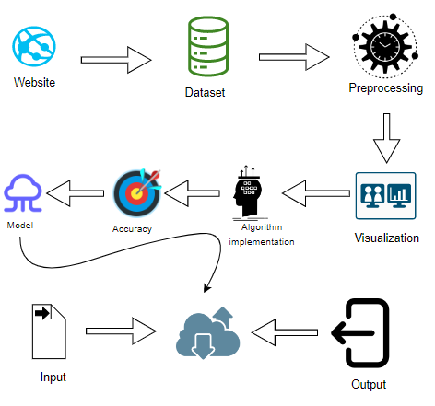
ARCHITECTURE DIAGRAM

Slide 13
MODULES
Data Pre-processing
Data Analysis of Visualization
Ada Boosting Classifier Alogorithm
Gradient boosting classifier Algorithm
Random forest classifier Algorithm
Deployment

Slide 14
Data Pre-processing
Validation techniques in machine learning are used to get the error rate of the Machine Learning (ML) model, which can be considered as close to the true error rate of the dataset.
If the data volume is large enough to be representative of the population, you may not need the validation techniques.
However, in real- world scenarios, to work with samples of data that may not be a true representative of the population of given dataset.
To finding the missing value, duplicate value, and description of data type whether it is float variable or integer.
The sample of data used to provide an unbiased evaluation of a model fit on the training dataset while tuning model hyper parameters.

Slide 15
Data Analysis and Visualization
Data visualization is an important skill in applied statistics and machine learning. Statistics does indeed focus on quantitative descriptions and estimations of data.
Data visualization provides an important suite of tools for gaining a qualitative understanding.
This can be helpful when exploring and getting to know a dataset and can help with identifying patterns, corrupt data, outliers, and much more.
With a little domain knowledge, data visualizations can be used to express and demonstrate key relationships in plots and charts that are more visceral and stakeholders than measures of association or significance.
Data analysis are whole fields themselves and it will recommend a deeper dive into some the books mentioned at the end.

Slide 16
Ada Boosting Classifier Algorithm
AdaBoost (Adaptive Boosting) is a popular ensemble learning technique that can be effectively used for early-stage diabetes prediction using machine learning.
In the context of diabetes prediction, AdaBoost can combine multiple weak classifiers to create a strong classifier that can accurately predict the likelihood of an individual developing diabetes at an early stage.
By leveraging AdaBoost for early-stage diabetes prediction, healthcare professionals can analyze various features and patterns in patient data to improve the early detection of diabetes.
This can lead to timely interventions, personalized treatment plans, and ultimately better health outcomes for individuals at risk of developing diabetes.

Slide 17
Gradient boosting classifier Algorithm
Gradient Boosting is a powerful machine learning technique that can be used for both regression and classification problems.
It is an ensemble learning method that combines the predictions of multiple weak learners (usually decision trees) to create a strong predictive model.
The key idea behind gradient boosting is to build trees sequentially, with each tree correcting the errors of the previous ones.
The process is guided by the gradient of the loss function with respect to the model's predictions.
Build a weak learner (usually a decision tree): Train a weak learner on the dataset.
A weak learner is a simple model that performs slightly better than random chance.

Slide 18
Random forest classifier Algorithm
Random Forest is a popular machine learning algorithm that belongs to the supervised learning technique.
It can be used for both Classification and Regression problems in ML.
It is based on the concept of ensemble learning, which is a process of combining multiple classifiers to solve a complex problem and to improve the performance of the model.
As the name suggests, "Random Forest is a classifier that contains a number of decision trees on various subsets of the given dataset and takes the average to improve the predictive accuracy of that dataset."
Instead of relying on one decision tree, the random forest takes the prediction from each tree and based on the majority votes of predictions, and it predictsthe final output.

Slide 19
Deployment
Deployment involves making your machine learning model accessible for use in a real-world setting.
This can include integrating the model into a web application, creating APIs, or deploying it on cloud platforms.
It's crucial to consider scalability, performance, and monitoring when deploying machine learning models.
For a comprehensive understanding of each topic, further study and practical application are recommended.

Slide 20
SOFTWARE ENVIRONMENT
SOFTWARE ENVIRONMENT
Operating System: Windows 10 or later
Tool : Anaconda with Jupyter Notebook
Language : python

Slide 21
HARDWARE ENVIRONMENT
HARDWARE ENVIRONMENT
Processor : Intel i3
Hard disk : minimum 80 GB
RAM : minimum 2 GB

Slide 22
Entity Relationship Diagram
RFC
Fraudent Behaviour Dataset
GRB
Supervised machine
Tunining
Model Selection
Predict of Diabetes
Trained Model

Slide 23
Dataflow Diagram
SOURCE DATA
DATA PROCESSING AND CLEANING
TRAINING DATA
TESTING DATA SET
CLASSFICATION ML
BEST MODEL BY ACCURACY
FINDING DIABETICS

Slide 24

Use Case Diagram
Datacollection
Classificatio n
data
data
Building model
Predicating
output

Slide 25
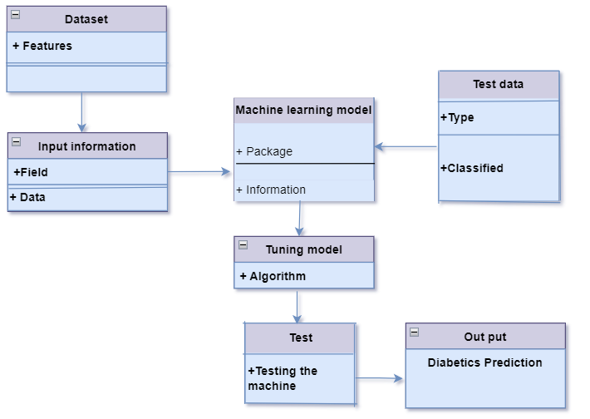
Class Diagram

Slide 26
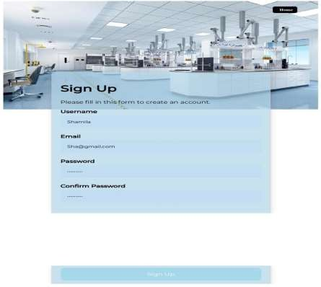
SAMPLE SCREENSHOTS
FIG.1 SIGN UP

Slide 27
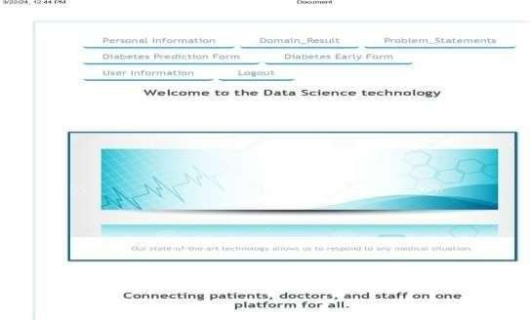
FIG.2 LOGIN

Slide 28
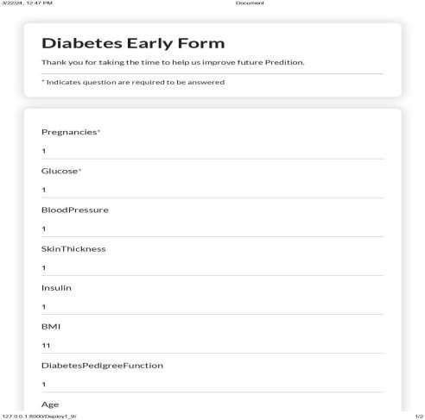
FIG.3 EARLYSTAGE FORM

Slide 29
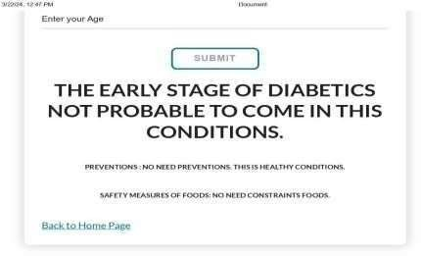
FIG.4 EARLYSTAGE RESULT

Slide 30
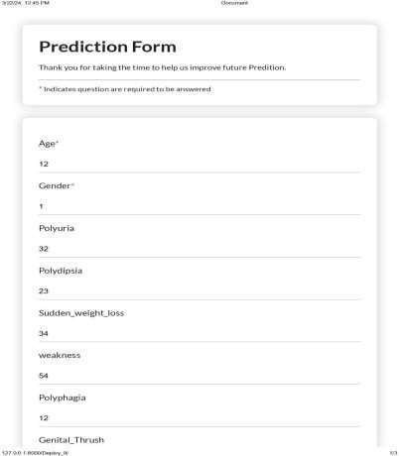
FIG.5 DIABETIC PREDICTION FORM

Slide 31
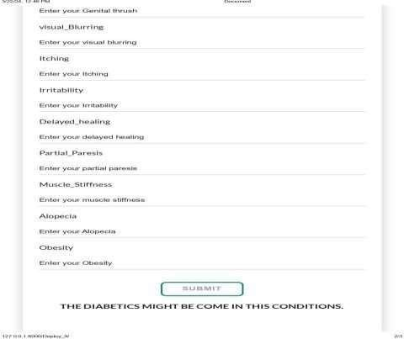
FIG.6 DIABETIC PREDICTION RESULT

Slide 32
CONCLUSION
The analytical process for identifying diabetes in patients typically begins with meticulous data cleaning and processing to ensure the quality and integrity of the dataset.
This involves tasks such as handling missing values, removing duplicates, and standardizing formats. Subsequently, exploratory analysis is conducted to gain insights into the data's structure and characteristics, uncovering potential patterns or anomalies.
Armed with a clear understanding of the data, predictive models are then constructed using various algorithms, ranging from traditional statistical methods to more advanced machine learning techniques.
These models are trained on the prepared dataset and evaluated rigorously to determine their effectiveness in accurately predicting diabetes.
Metrics such as accuracy, precision, and recall are utilized to assess model performance.
The model exhibiting the highest accuracy score on a public test set is identified as the most suitable candidate for deployment.

Slide 33
FUTURE ENHANCEMENT
It is truly remarkable how advancements in technology are transforming HealthCare, particularly in the realm of diabetes prediction and personalized medicine.
By incorporating real-time data from wearable technology and mobile health apps, we can significantly improve the accuracy and efficiency of diabetes prediction models.
This, in turn, enables us to offer personalized recommendations tailored to everyone’s specific health indicators and medical background.
The potential for customized diet, exercise plans, and medication regimens based on this data is incredibly promising and has the potential to greatly enhance patient care and outcomes.

Slide 34
REFERENCE
L. DiMeglio, C. Evans-Molina, and R. Oram, “Type 1 diabetes,” Lancet, vol. 391, pp. 2449–2462, Jun. 2018.
C. Cobelli, C. D. Man, G. Sparacino, L. Magni, G. D. Nicolao, and B. Kovatchev, “Diabetes: Models, signals and control,” IEEE Rev.Biomed. Eng., vol. 2, pp. 54–96, 2009.
E. Bekiari et al., “Artificial pancreas treatment for outpatients with type 1 diabetes: Systematic review and meta-analysis,” Brit. Med. J., vol. 361, Apr. 2018, Art. no. k1310.
H. Thabit and R. Hovorka, “Coming of age: The artificial pancreas for type 1 diabetes,” Diabetology, vol. 59, no. 9, pp. 1795–1805, 2016.
T. Peyser, E. Dassau, M. Breton, and J. S. Skyler, “The artificial pancreas: Current status and future prospects in the management of diabetes,” Ann. New York Acad. Sci., vol. 1311, no. 1, pp. 102–123, Apr. 2014.

Slide 35
D. Shi, S. Deshpande, E. Dassau, and F. J. Doyle III, Feedback Control Algorithms for Automated Glucose Management in T1DM: The State of the Art, 1st ed. San Diego, CA, USA: Academic, 2019.
G. M. Steil, K. Rebrin, C. Darwin, F. Hariri, and M. F. Saad, “The effect of insulin feedback on closed loop glucose control,” J. Clin. Endocrinol. Metabolism, vol. 55, pp. 3344–3350, Dec. 2016.
G. M. Steil, K. Rebrin, C. Darwin, F. Hariri, and M. F. Saad, “Feasibility of automating insulin delivery for the treatment of type 1 diabetes,” Diabetes, vol. 55, no. 12, pp. 3344–3350, Dec. 2006.
P. Herrero, P. Georgiou, N. Oliver, D. G. Johnston, and C. Toumazou,
“A bio-inspired glucose controller based on pancreatic β-cell physiology,”
J. Diabetes Sci. Technol., vol. 6, no. 3, pp. 606–616, May 2012.
R. Hovorka et al., “Nonlinear model predictive control of glucose concentration in subjects with type 1 diabetes,” Physiolog. Meas., vol. 25, no. 4, pp. 905–920, 2004.

Slide 36
B. Grosman, E. Dassau, H. C. Zisser, L. Jovanoviˇc, and F. J. Doyle, III, “Zone model predictive control: A strategy to minimize hyper and hypoglycemic events,” J. Diabetes Sci. Technol., vol. 4, no. 4,
pp. 961–975, 2010.
Aishwarya Mujumdar, Dr. Vaidehi “ Diabetes Prediction using Machine Learning Algorithms” 2019.
Talha Mahboob Alama, Muhammad Atif Iqbala “ A model for early Prediction of Diabetes “ , 2019.
KM Jyoti Rani “ Diabetes Prediction Using Machine Learning ” 2020
Jingyu Xue “ Research on Diabetes Prediction Method Based on Machine Learning “ 2020 .

Slide 37
THANK YOU

